Slide 1
Programming Foundations: Decisions
Chris Walshaw
Computing & Mathematical Sciences
University of Greenwich

Slide 2
Lecture Objectives
Quite a number of topics …
conditional statements
the boolean data type
logical operators
comparison operators
But mostly straightforward to use

Slide 3
Motivation
We have now built a number of calculator pages (add / subtract / multiply / divide)
We would like to combine them in one program
… but how do we know which operation the users wants (add, subtract, …)
We need to make a decision based on some other input

Slide 4
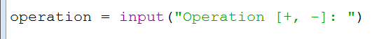
User input
We can ask the user which operation they want with the input() command
e.g. +, -
This gives us a string variable named operation to consider
If operation is “+”
then we add the two numbers
If operation is “-”
then we subtract the two numbers

Slide 5
Conditionals: the if statement
We can use conditional statements to make a decision whether to do something in a program or not
The general syntax of a conditional is
if condition:
statement 1
statement 2
...
where statement 1, statement 2, etc, will only be executed, if the condition is true
https://www.w3schools.com/python/python_conditions.asp

Slide 6

Using if statements
Returning to our example we need to decide whether “operation” contains “+” or “-”
In Python this is done with the “==” operator
this is known as a comparison operator
read “==” as “is equal to”

Slide 7
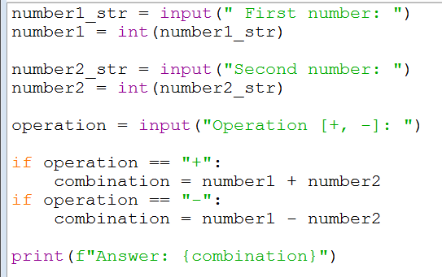
01Calculator_if
The whole program is
read in the 1st number and convert to integer
read in the 2nd number and convert to integer
read in the operation
do the calculation depending on which operation is chosen
output the answer using f-string formatting

Slide 8
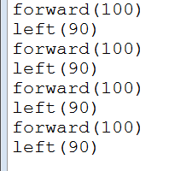
Flow of control
In all the previous examples the flow of control through the program has been a downward stream of steps
statement 1
statement 2
for example, to draw a square
statement 3
statement 4

Slide 9
Conditional flow of control
Conditionals change the flow of control through the program
if the condition is not true, these statements are never executed
statement
if condition
condition true
statement
condition false
statement
statement

Slide 10
Conditionals: the else statement
There’s a bit of redundancy in 01Calculator_if
if the operation is not “+”, then (assuming the user hasn’t done something wrong) it must be “-”
So we don’t actually need to check if operation is “-”
Instead we can use an else statement
(strictly speaking it’s an else clause, not a statement, as it cannot stand on its own – however, for simplicity let’s call it a statement)
if condition: statements to be executed
if the condition is true else: statements to be executed
if the condition is false
else must accompany an if statement
else statement

Slide 11
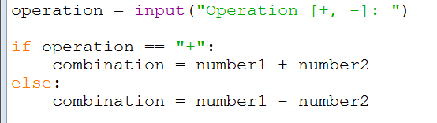
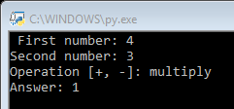
Using else statements
02Calculator_ifElse makes use of this new construction
But what if the user doesn’t type “+” or “-”?
the program always does subtraction (unless the user types “+”)

Slide 12
Defensive programming
02Calculator_ifElse makes the assumption that if the user didn’t type in “+” they must have typed in “-”
It is wildly optimistic to assume that users will never do something wrong
users will always do something you don’t expect
Nonetheless, we only need to check if operation is “-”, if we know it is not “+”
so 01Calculator_if still contains redundancy
but 02Calculator_ifElse is risky

Slide 13
Conditionals: the elif statement
The elif statement allows us to check another option
short for “else if”
if condition1:
statements to be executed
if condition1 is true
elif condition2:
statements to be executed
if condition1 is false
and condition2 is true
elif must accompany an if statement
elif statement

Slide 14

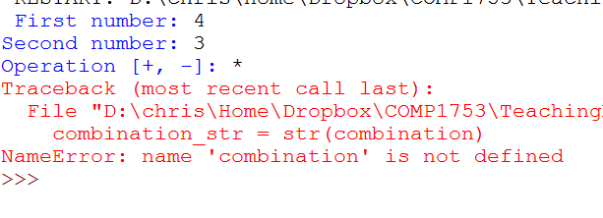
03Calculator_ifElif
The new code looks like this
It will generate an error if the user doesn’t type in “+” or “-” when prompted for the operation

Slide 15
Conditionals: the elif statement
In fact elif can be used multiple times
if condition1:
statements to be executed
if condition1 is true
elif condition2:
statements to be executed
if condition1 is false
but condition2 is true
elif condition3:
statements to be executed
if condition1 & condition2 are false
but condition3 is true elif condition4:
statements to be executed
if condition1 to condition3 are false
but condition4 is true ...
elif statement
another elif
yet another elif
and there could be more

Slide 16
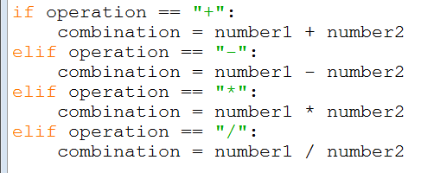
04Calculator_ifElifElif
Now we can offer multiplication and division as well

Slide 17
Defensive programming (2)
04Calculator_ifElifElif now offers all 4 operations … but it will still generate an error if operation is not recognised
We need a way to identify any other input and give the user a more helpful error message
We can do this by adding an else statement after all the elif statements

Slide 18
Conditionals combined
The most general conditional combines if, elif and else
if condition1:
statements to be executed
if condition1 is true
elif condition2:
statements to be executed
if condition1 is false
but condition2 is true
elif condition3:
statements to be executed
if condition1 & condition2 are false
but condition3 is true ...
else:
statements to be executed
if none of the conditions are true
if statement
elif statement
another elif
there could be more
else statement to finish

Slide 19
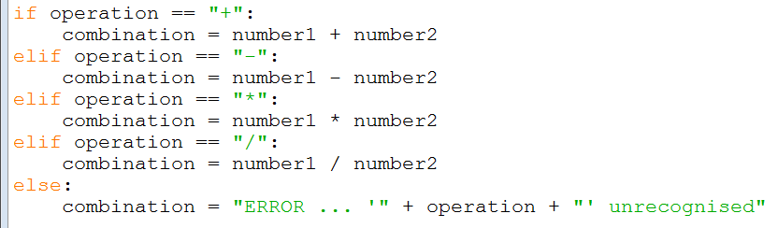

05Calculator_ifElifElse
Now the user gets a helpful error message if they do something wrong

Slide 20
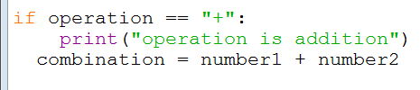
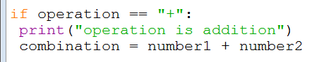
Indentation
Notice that all the statements after if, elif and else are indented
Python is very fussy about indentation
most other programming languages are not …
e.g. Java, JavaScript, C, C++, C#, … all use curly braces { } instead
Not only must everything be indented after if, elif and else but also it must all be indented the same amount
However, provided it is consistent, you can use as many spaces as you like for indentation
all the Programming Foundations examples use 4 spaces and IDLE inserts this automatically for you
this would cause an error (indentation doesn’t match)
no error (only 1 space, but consistent)

Slide 21
Concessions
The next set of examples work out whether the user gets a concessionary price, depending on their status
The examples will allow us to explore conditional statements (and their conditions) in more detail

Slide 22
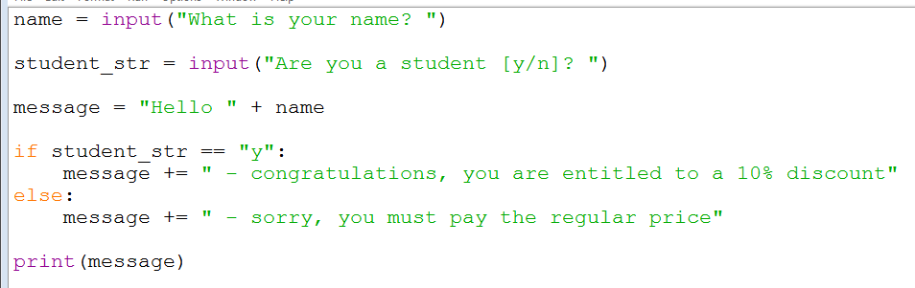
06Concessions
The first version just offers the user 10% off if they are a student

Slide 23
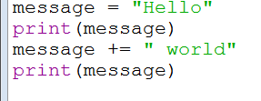

The “+=” operator
Notice 06Concessions has a new feature (nothing to do with conditionals)
When used with strings, the “+=” symbol glues the string on the right hand side onto the variable on left hand side
After using “+=” the variable message contains the string “Hello world”

Slide 24
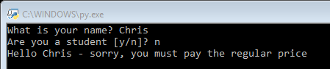
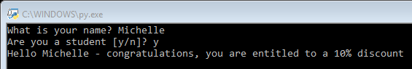
06Concessions
Output from 06Concessions looks like

Slide 25
Booleans
Recall the data types from last week
Numbers – have a numerical value like 2 or 1.4
Strings – contain text like “Michelle Obama”
Booleans are another data type
named after George Boole, an English mathematician (1815-1864), who worked in algebraic logic
Booleans only have two possible values – True or False
We can use them to make conditionals look a bit more readable

Slide 26
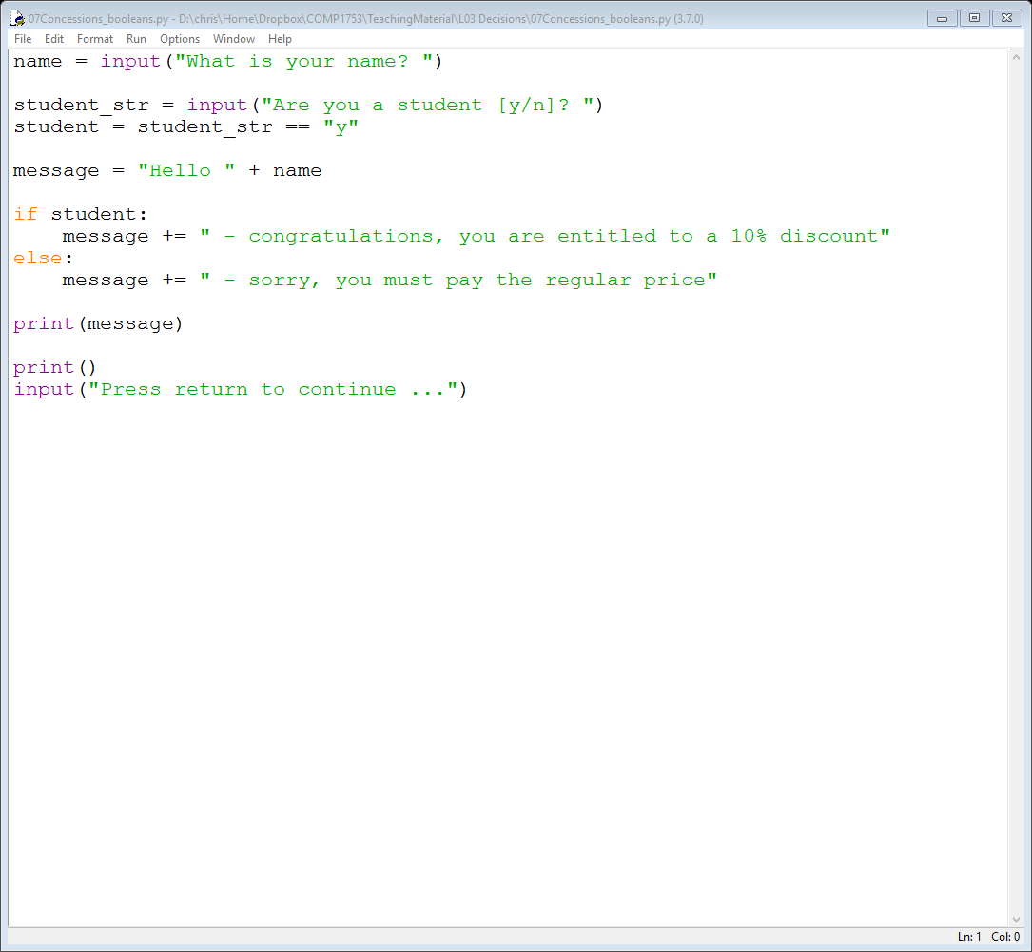
07Concessions_booleans
The next version uses a boolean variable called student set to True or False depending on how the user responded
if student_str is input as anything else, then student takes the value False
if student_str is input as “y”, then student takes the value True

Slide 27
07Concessions_booleans
This makes the conditional clearer

Slide 28
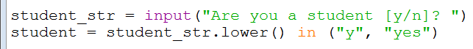

08Concessions_inOperator
The next version has two additional enhancements
student_str.lower() converts the contents of student_str to lower case
in ("y", "yes") returns True if the string is either “y” or “yes”
So student is set to True if the user responds with “Y”, “y”, “YES”, “Yes”, “yes”, “yES”, “YeS”, … or, in fact, any capitalisation of “y” or “yes”

Slide 29
Comparison operators
The next version has additional features
users are offered a concession if they are a student or if they are 18 or under
So we need more comparison operators:
Operator | Meaning | Example
== | equal to | age == 25
!= | not equal to | age != 0
< | less than | age < 5
> | greater than | age > 70
<= | less than or equal to | age <= 18
>= | greater than or equal to | age >= 25
https://www.w3schools.com/python/python_operators.asp

Slide 30
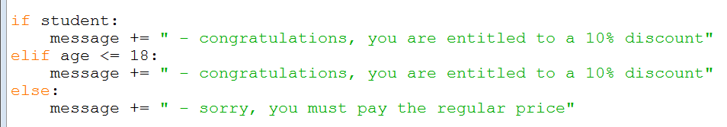
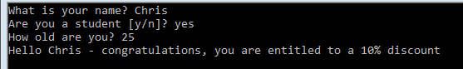


09Concessions_elif
The conditional code is now

Slide 31
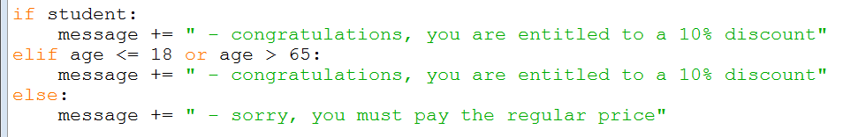
10Concessions_orOperator
To complicate matters, the company also want to offer concessions to anyone over the age of 65
We could do this with another elif statement but an alternative is to use the or operator

Slide 32
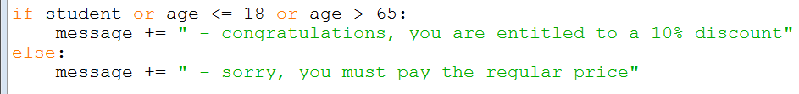
11Concessions_orOperators
You can also use multiple or operators
3 different ways to get a concessionary price
In the next version, the company wants to give a 20% discount to people who are students and either, under 18, or, over 65
but most students are 18-21 so the company is not being particularly generous!

Slide 33
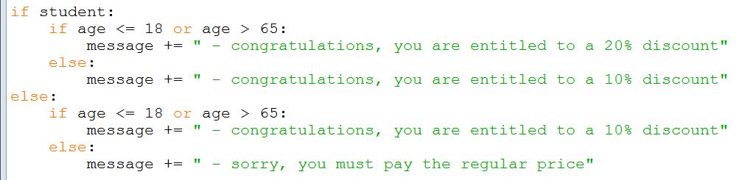
12Concessions_nestedIfs
One way to achieve this is by nesting if / else statements inside each other
student and young/old
student but not young/old
not student but young/old
not student and not young/old

Slide 34
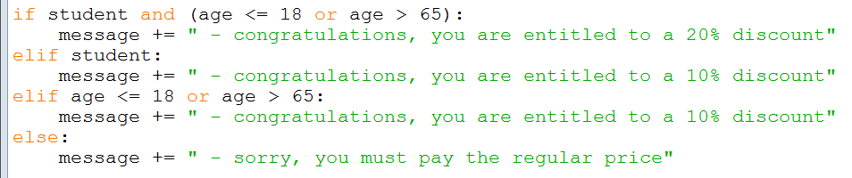
13Concessions_andOperator
Another way is to use the and operator
Notice the brackets – 20% concession if student and (age <= 18 or age > 65)

Slide 35
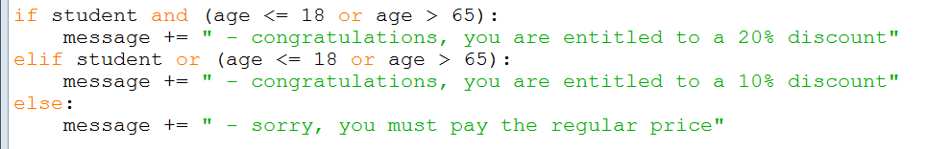
14Concessions_orOperators
In programming it is (almost) always better to reduce duplication
This version gets rid of the duplicate messages about 10% discount

Slide 36
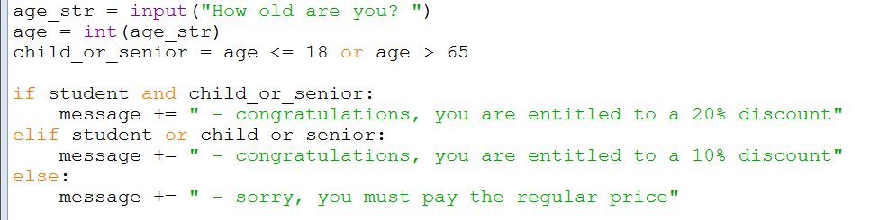
15Concessions_booleans
Notice the duplication of finding out if the user is under 18 or over 65
Instead we can introduce another boolean variable, child_or_senior

Slide 37
The not operator
The child_or_senior variable is an awkward way of expressing things
Sometimes it’s better to express the opposite
i.e. someone who is not a child nor a senior citizen pays the regular adult price
So could use a boolean variable for this
adult = age > 18 and age <= 65
And then use the not operator, as in
if not adult:

Slide 38
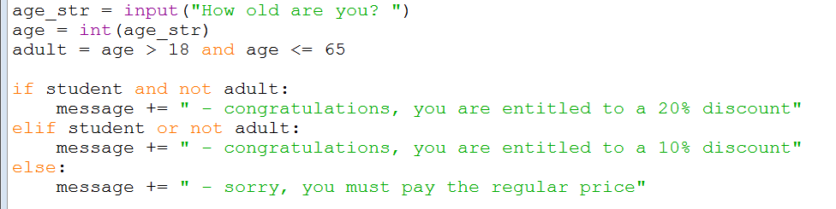
16Concessions_notOperator
The next version then becomes
Which is arguably more readable

Slide 39
Choices, choices
Notice there are several different ways of achieving the same thing
examples 12 – 16 all do exactly the same thing
There is no one correct version – it is more about deciding which is easier to understand / more elegant
which is why programming is sometimes described as an art rather than a science
Personally, my preferred version is 14, but you may have other ideas
However, you should
ideally, know how to code all of these versions, if required
or, at the very least, understand how each of them works

Slide 40
Validation
Finally, if you tried running 15RandomValues from last week, you may have noticed it gives an error if the maximum value input by the user is less than the minimum value
sounds like a good opportunity for a conditional!
We can now use a conditional statement to include some validation
validation checks that the user’s input is sensible
you should always try to use validation for your programs!

Slide 41
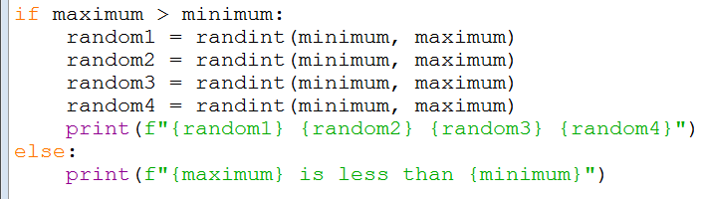


17RandomValues_validation
The code now becomes

Slide 42
Summary
We have covered quite a lot today …
Conditional statements
if, elif, else
The boolean data type
Logical operators
or, and, not
Comparison operators
==, >, <, >=, <=
Other stuff
+= for strings, in operator, .lower() for strings, validation, …

